Slide 1
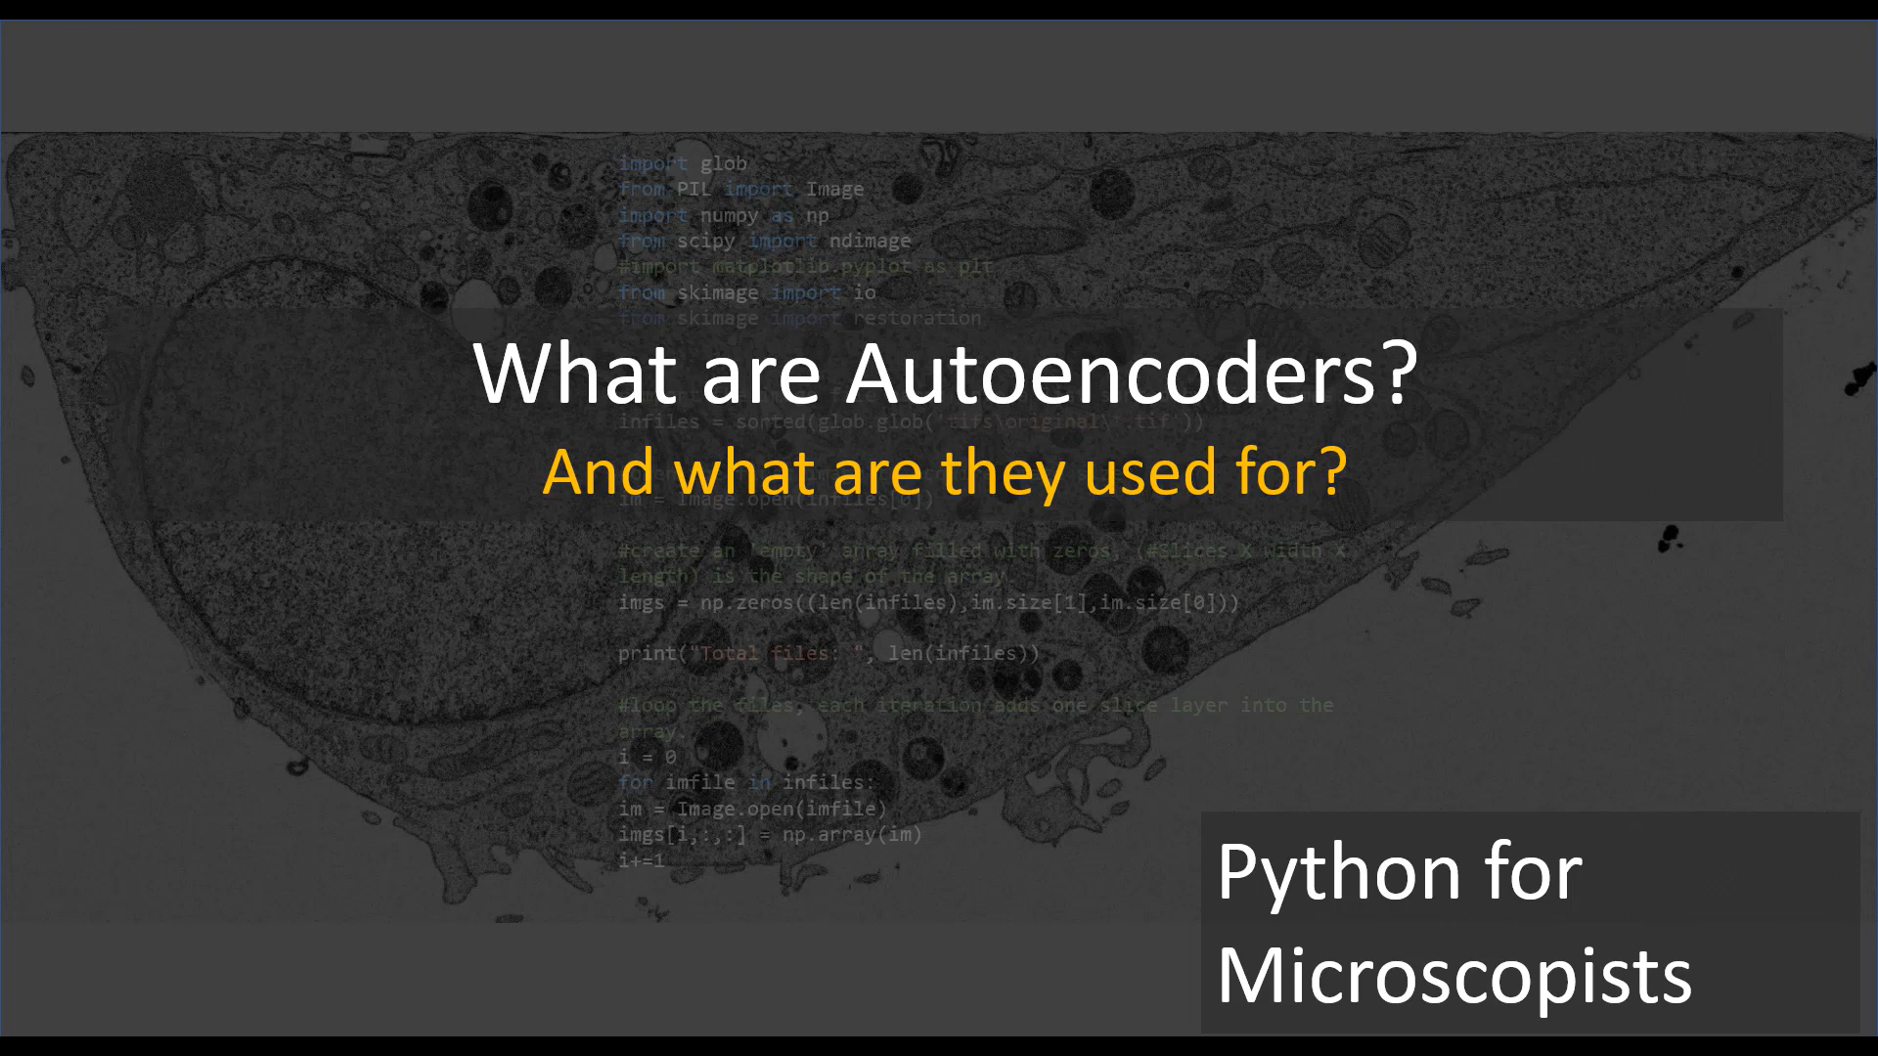

Slide 2
An autoencoder is a type of neural network that learns to compress and reconstruct data efficiently, working like a smart data compressor and reconstructor..
Core Mechanism:
Encoder: Compresses input data into a smaller, dense representation
Decoder: Reconstructs the original input from the compressed representation Key
Components:
Input layer: Original data
Hidden layer: Compressed data representation
Output layer: Reconstructed data matching original input

Slide 3
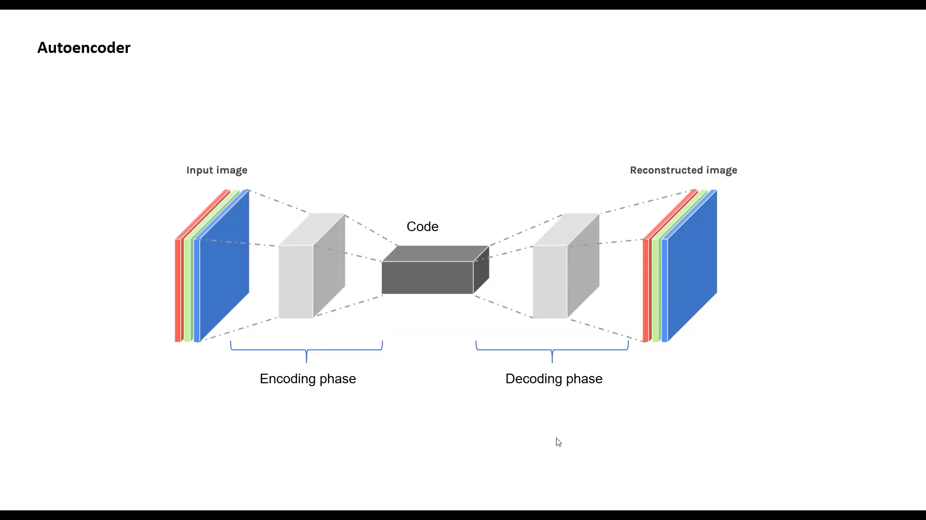

Slide 4
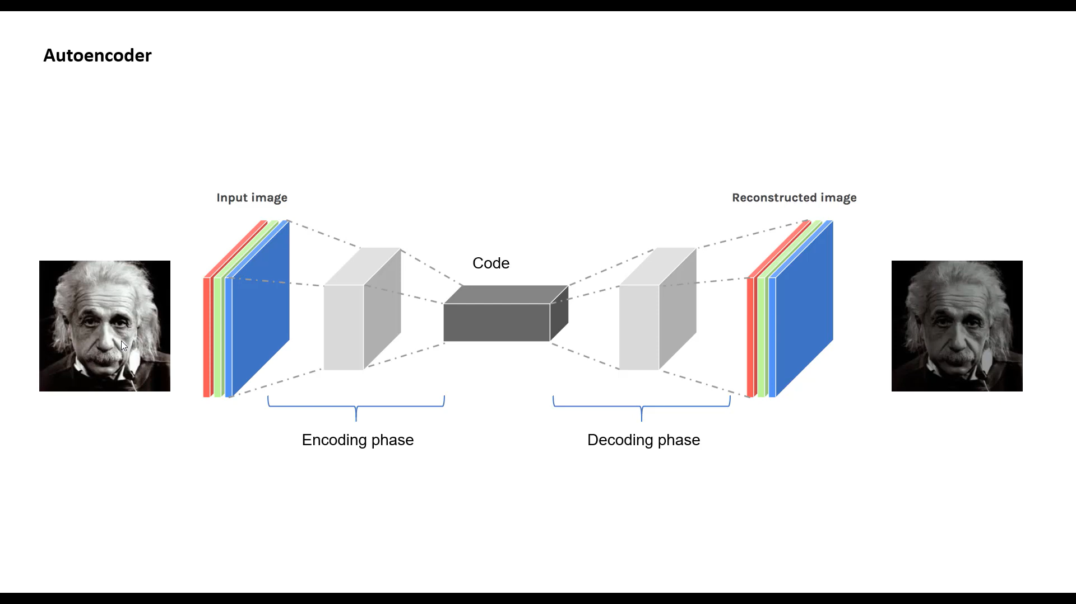

Slide 5
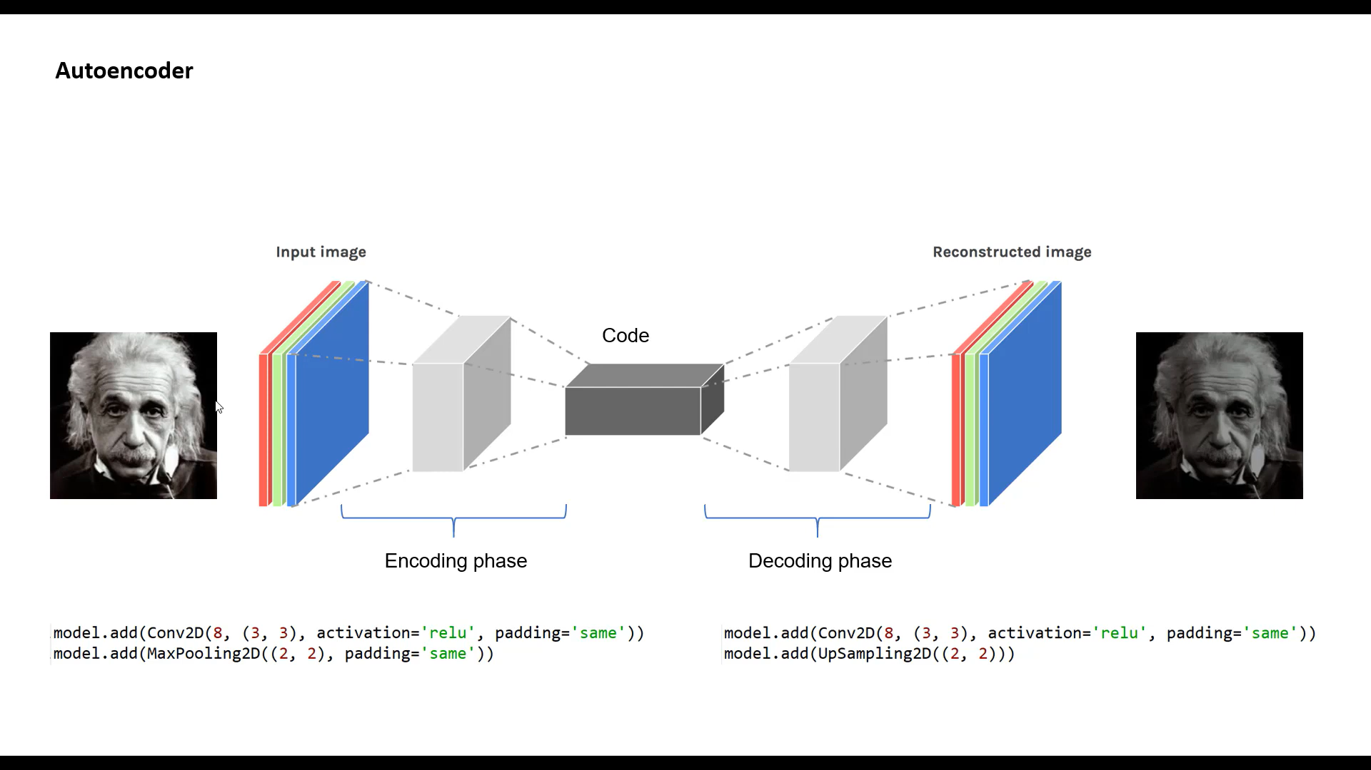

Slide 6
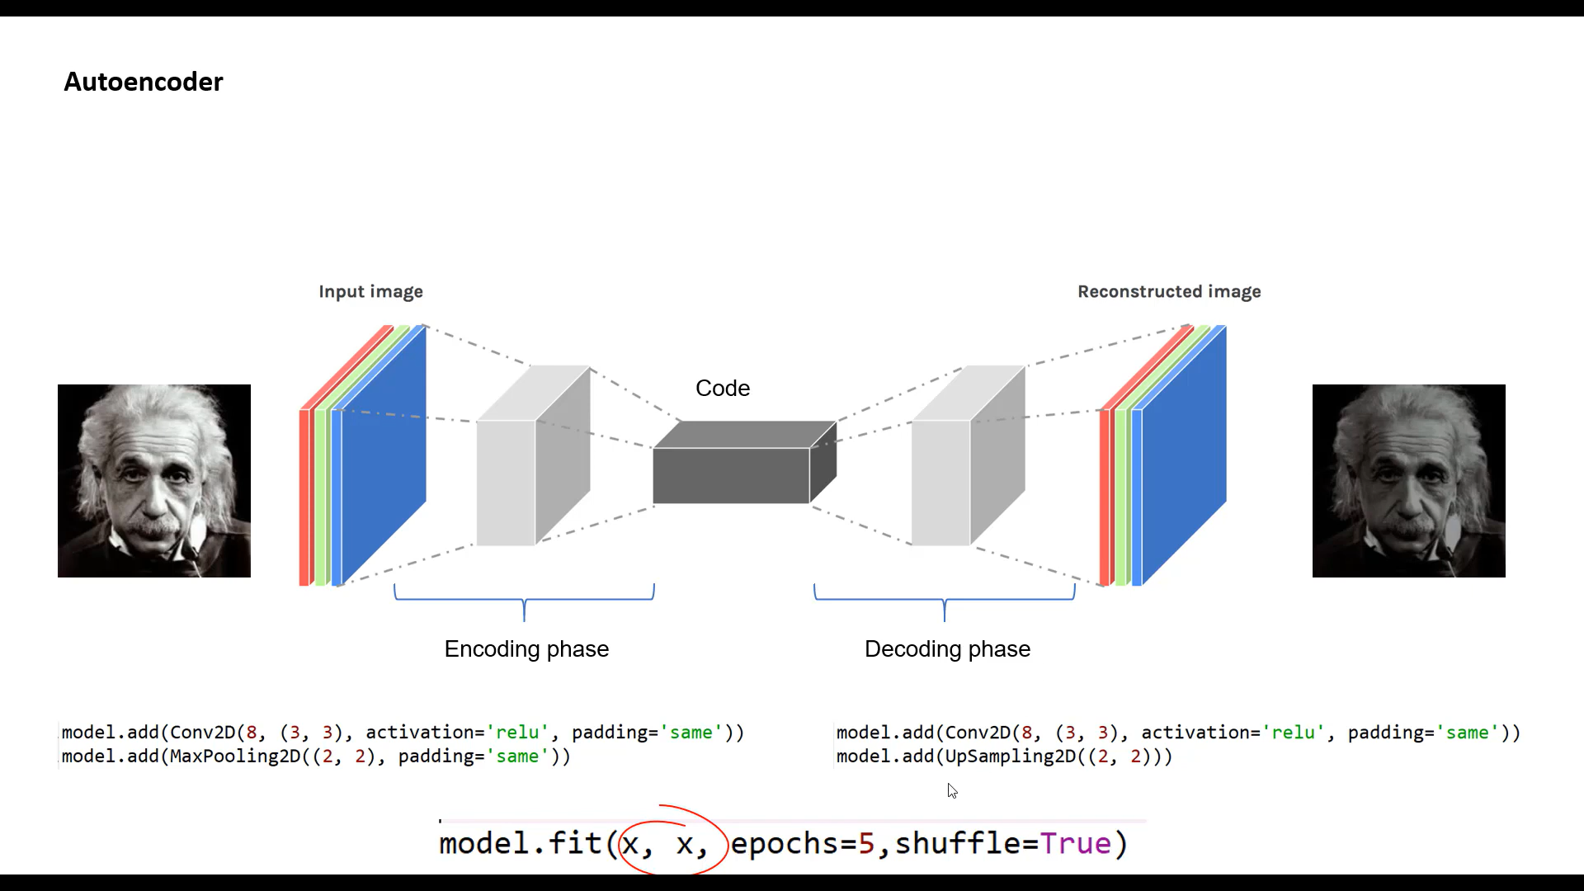

Slide 7
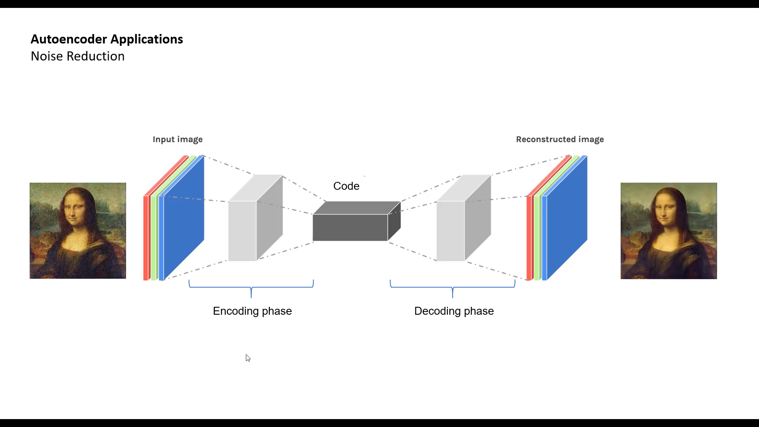

Slide 8
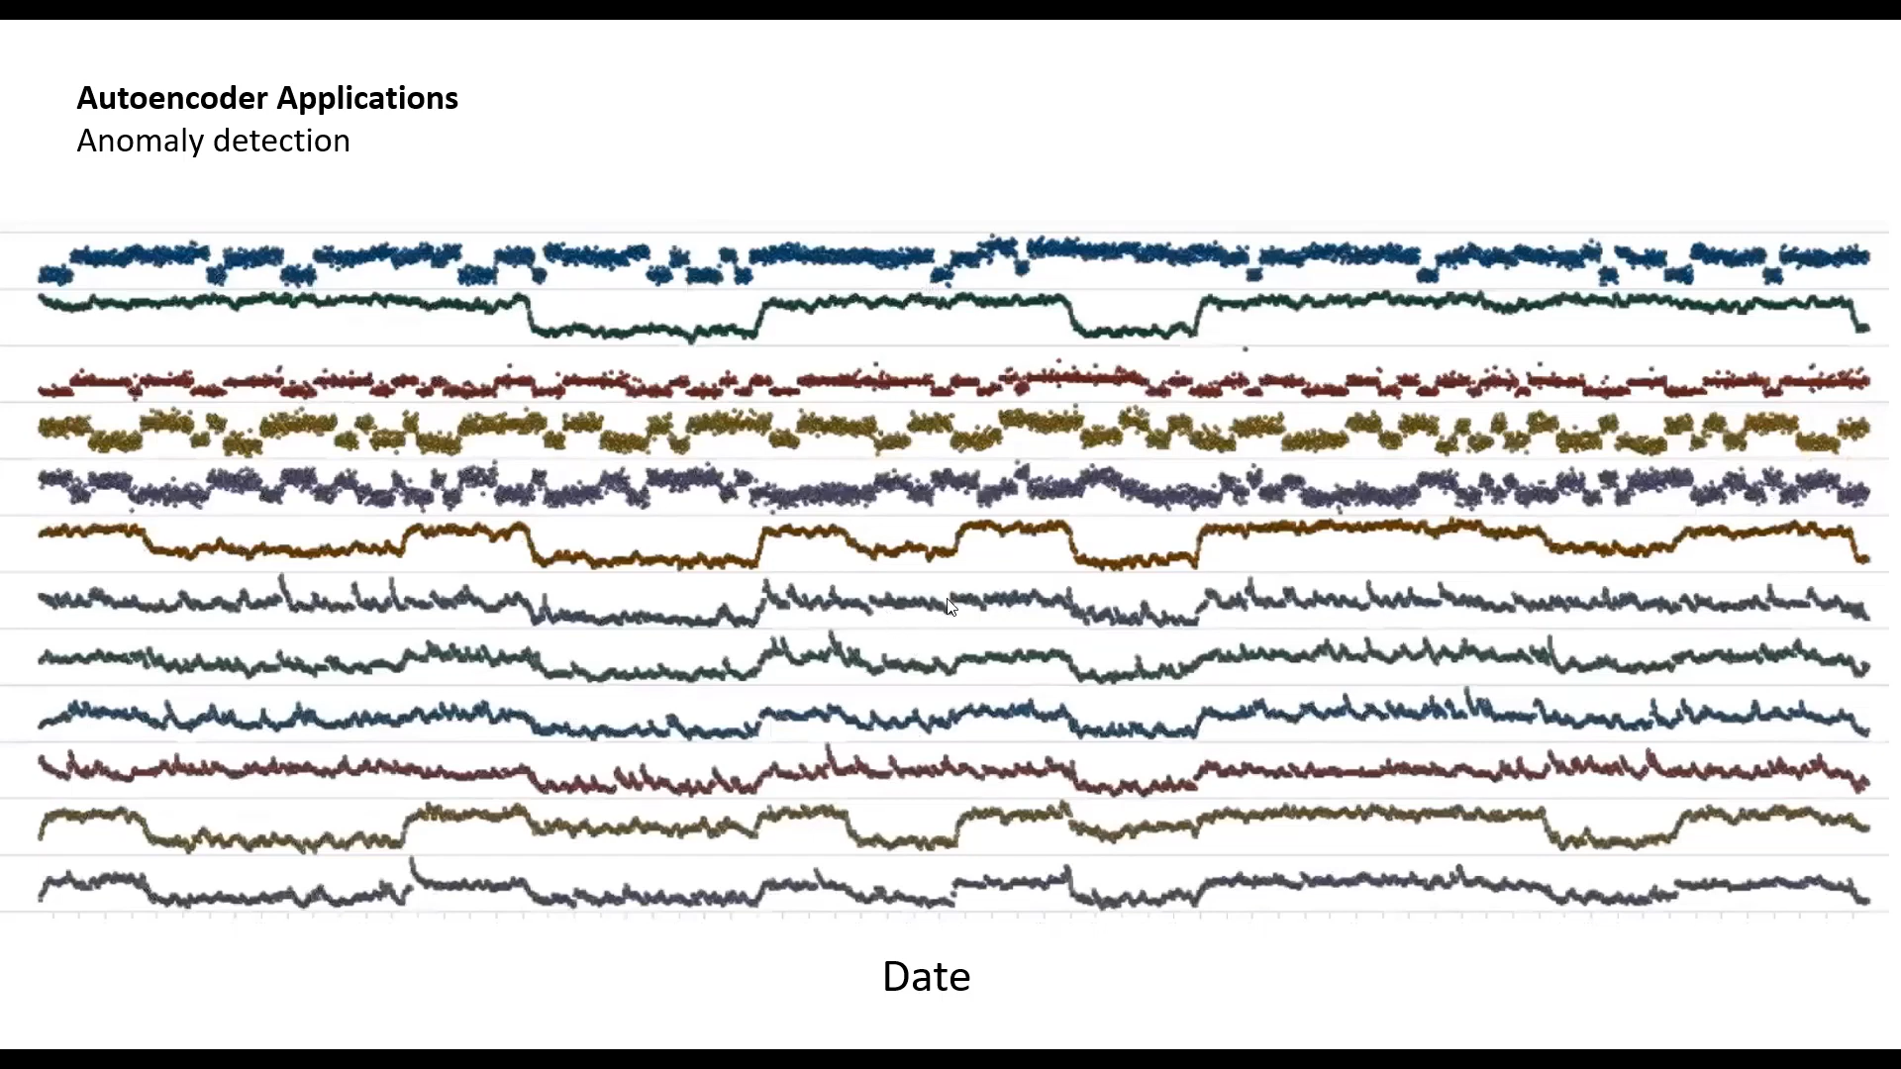

Slide 9
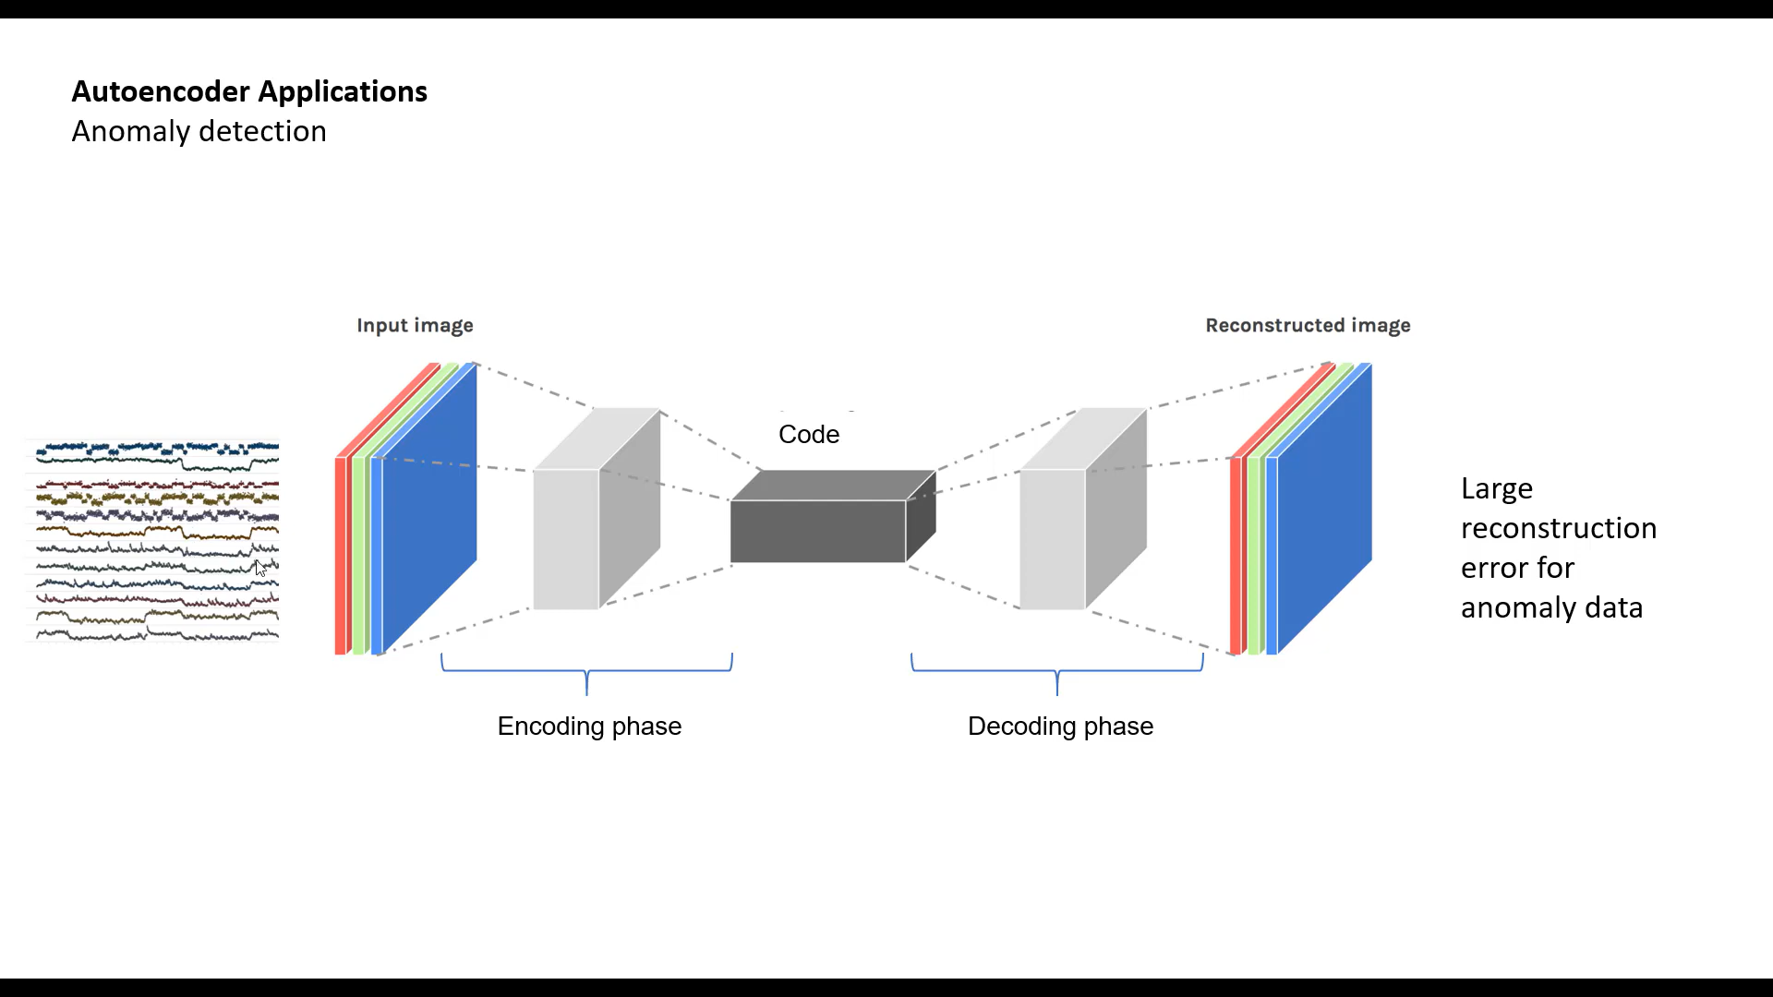

Slide 10
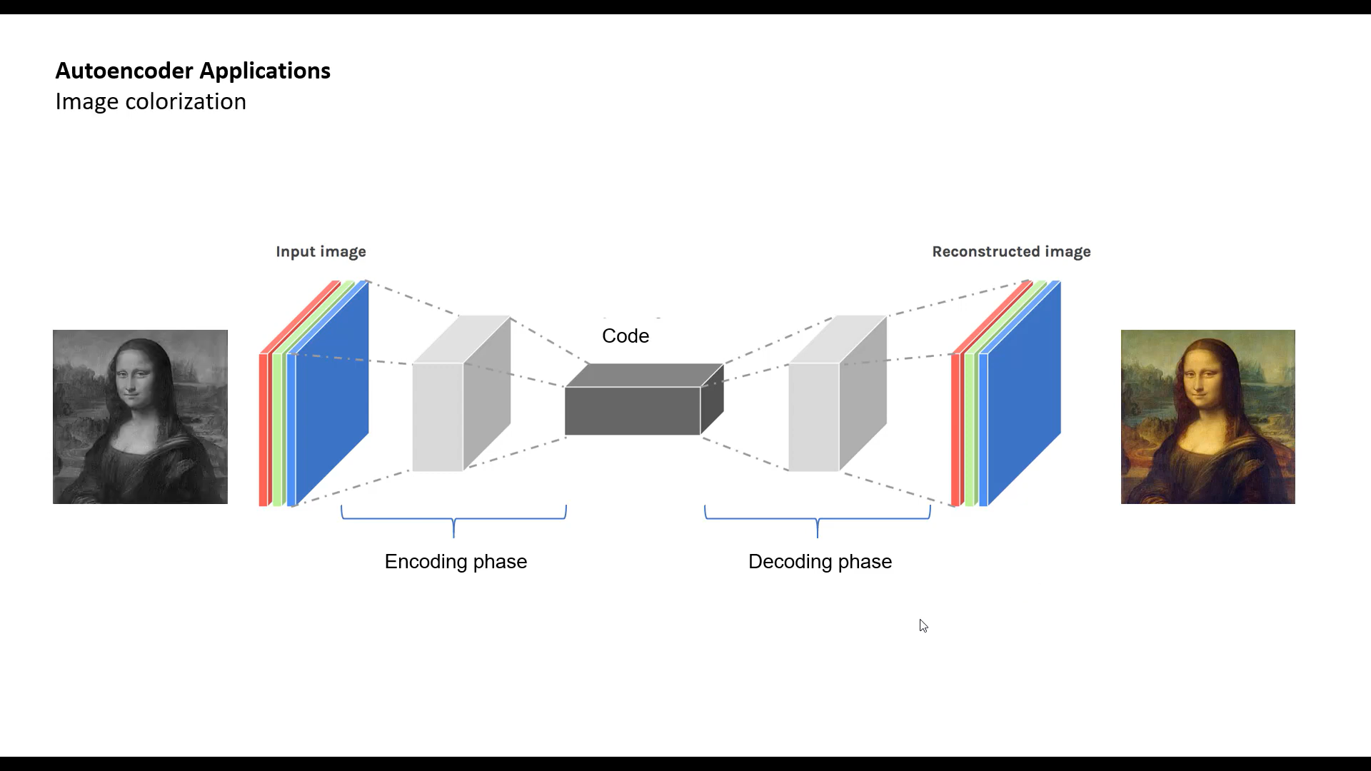

Slide 11

Introduction to VAE
107

Slide 12

Understanding Variational Autoencoders (VAEs)
VAE: A Milestone Paper
Original Paper:
Link: https://arxiv.org/abs/1312.6114

Slide 13
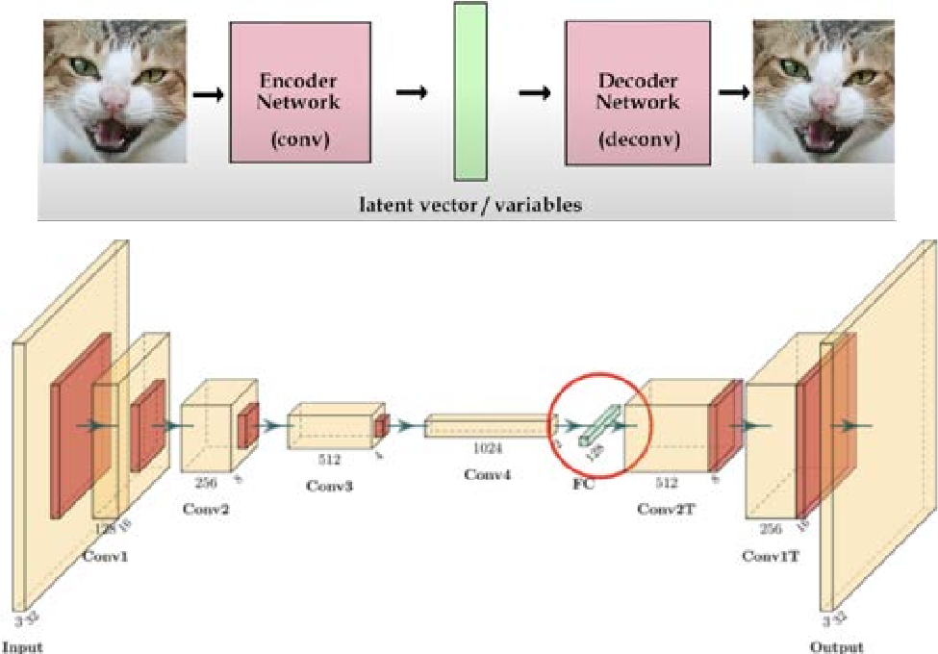
How does Variation Encoder work?

Slide 14
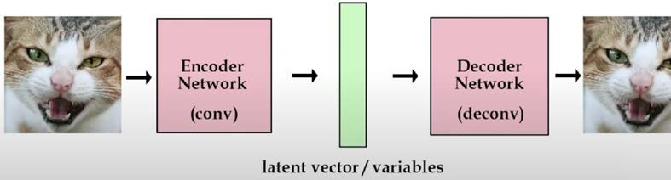
Traditional Auto Encoders

Slide 15
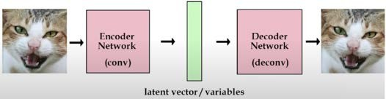
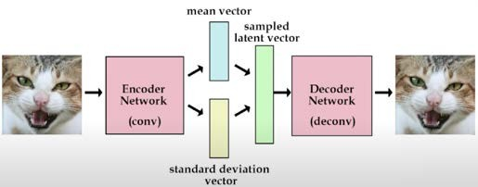
Paper: Variation Autoencoder (VAE)
Traditional Autoencoder
Variation Autoencoder

Slide 16
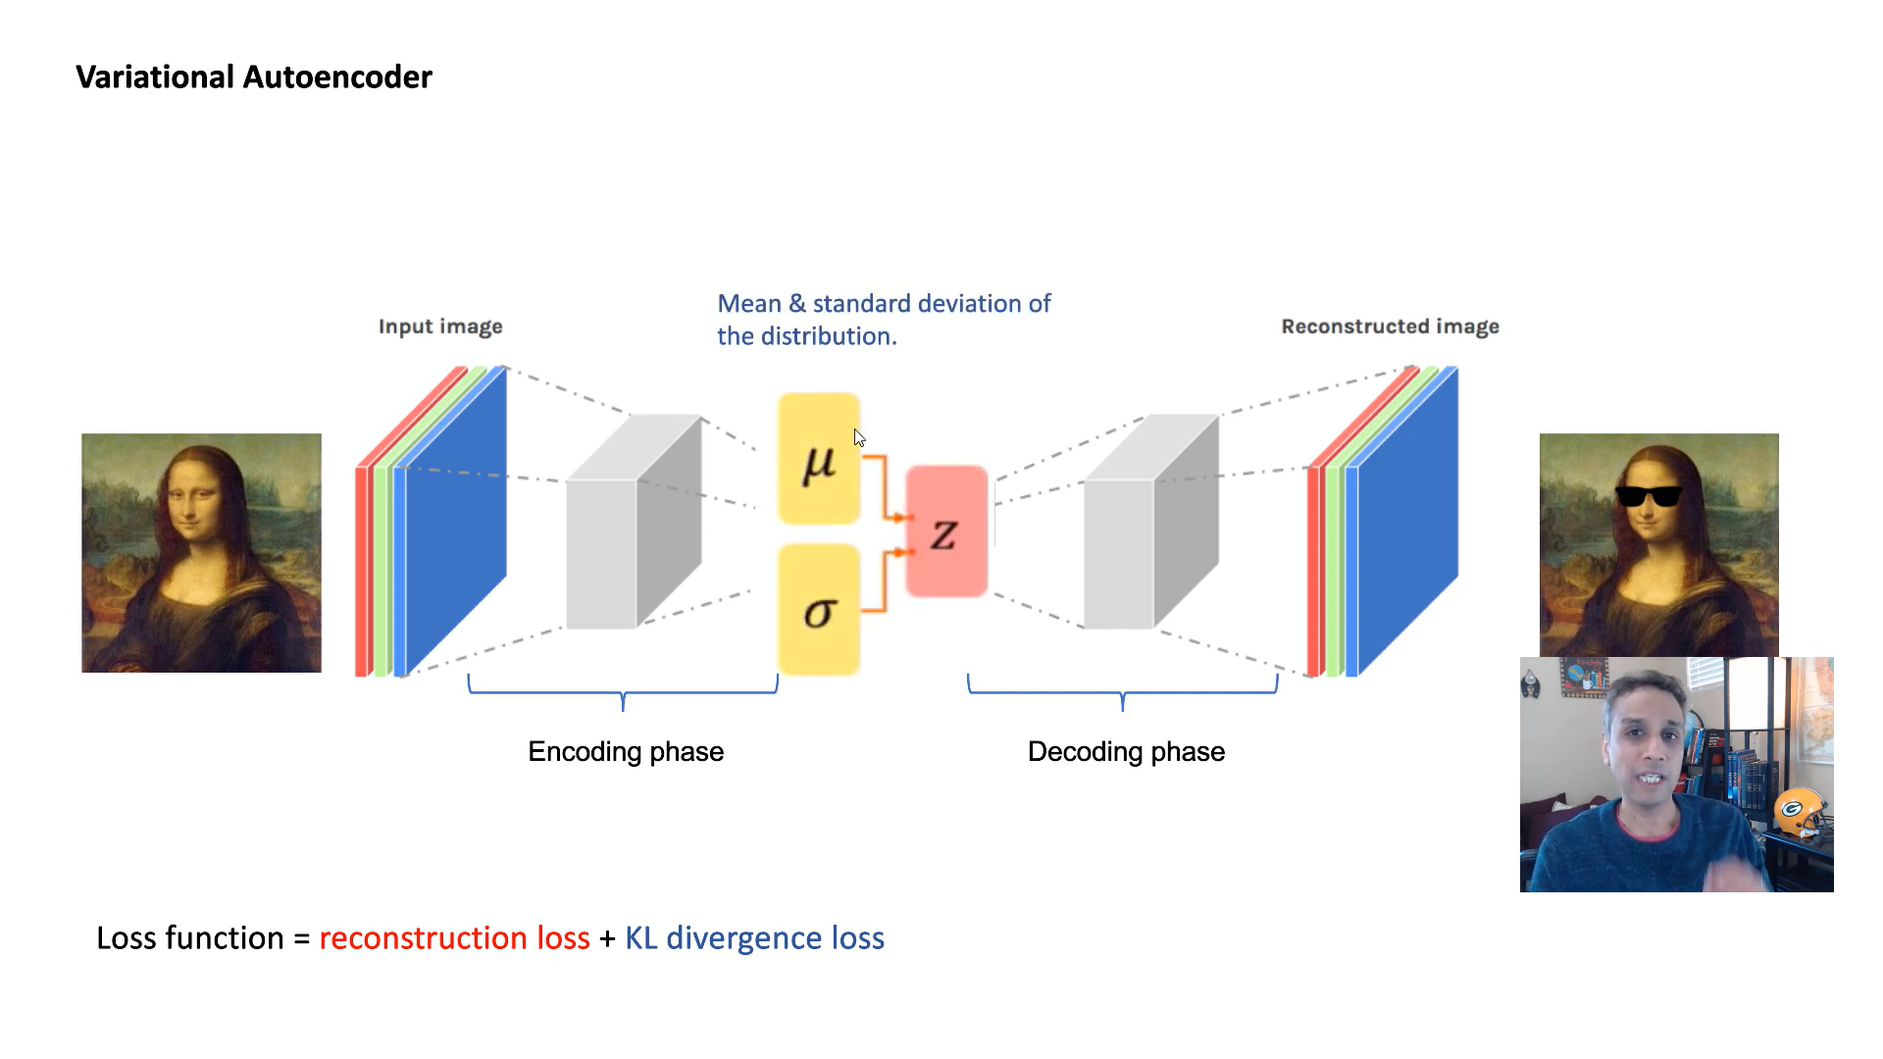

Slide 17
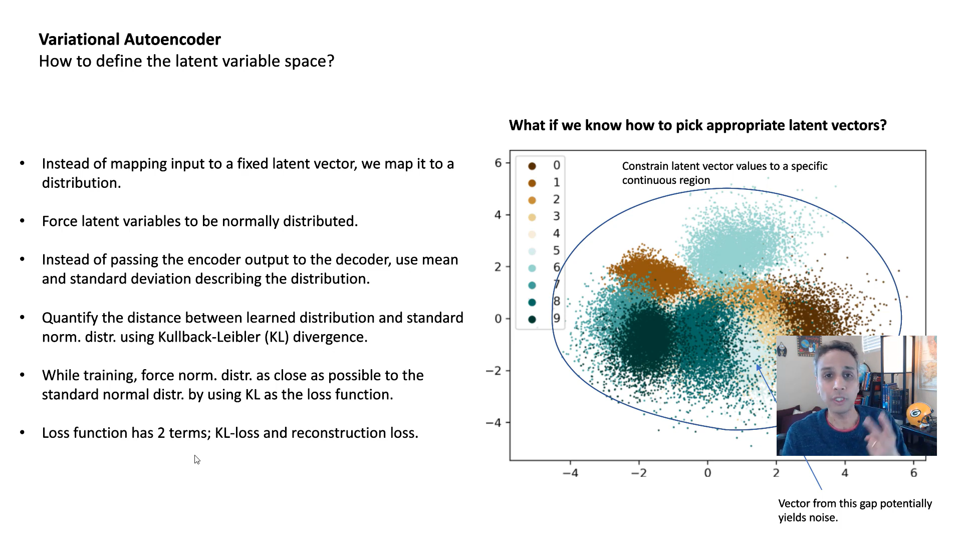

Slide 18
Data Distribution Loss from Gaussian
Loss in Variation Auto Encoder
Reconstruction Loss
Additional in Variation Auto Encoder

Slide 19
Applications of VAE
120

Slide 20
Applications of VAEs
Denoising
In- painting

Slide 21
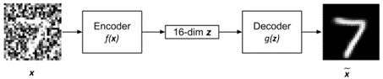
1. Denoising

Slide 22

2. In-painting

